Slide 1

Chef in the box
Group 4:
Alexandra Marian
Bogdan-Cătălin Ianchiș
Iliuță-Laurențiu Andoni
Marius-Alexandru Guriță
Sorin-Ionuț Rosalim

Slide 2
Product description
We provide customers with a modular system that allows them to cook high-quality meals from the comfort of their homes;
The system configuration is highly customizable to fit in every kitchen.

Slide 3
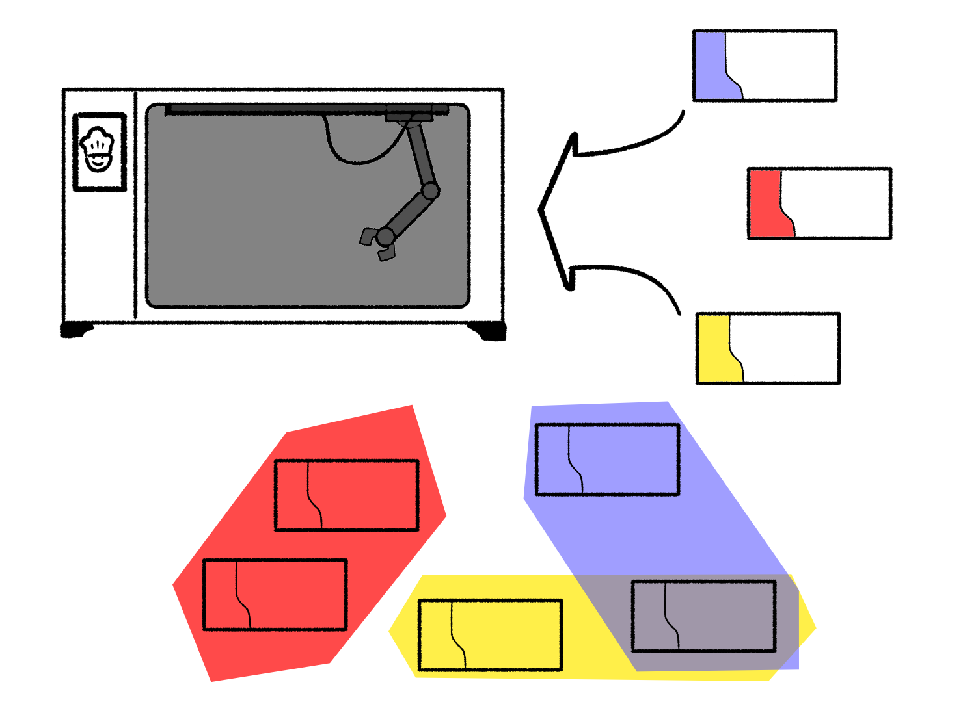
Technical details

Slide 4
Subsystems requirements
Webshop
Manufacturing Execution System
Shop Floor and Robotics
Warehousing and Logistics
Monitoring and Analytics

Slide 5
Webshop
Friendly Website
Email Marketing tools
Social media integration
Customer Support
Payment
Shopping Cart Software
Contact and Privacy Page
Stable performance
Return policy
Different languages
Retailers
Product configuration
User generated reviews
Up-to-date catalog

Slide 6
Manufacturing Execution System
Object identification
Data sheet
Necessary materials
Information validation
Efficient communication
Product mapping
Entry interpretation
Shop Floor issues

Slide 7
Shop Floor and Robotics
Continuous production
Production in advance
Quality Tests
Busy production line
Live data
Research department
Future expansions
Data analysis
Intersystem communication
Inspection

Slide 8
Warehousing and Logistics
Capacity control
Monitoring raw material
Monitoring finished products
Ordering more/less raw material
Internal logistics
Proper transportation method
Package handling
Depositing returned products with different problems
Depositing returned finished products with no problems
Connection with other subsystems

Slide 9
Monitoring and Analytics
Faulty data detection
Trend detection
Acquire proper data from MES
Process analysis
Customer feedback subsystem
Warehouse ordering subsystem
Technical timestep ordering
Web Shop stock status
Assembly line efficiency
Cost efficiency calculation
Inter department communication

Slide 10
System's requirements
Final product delivery
Customer control
Fluid communication
Optimal data processing
Continuous operation
Customer support
Maintenance
Verification
Customer data protection
Response time

